Slide 1
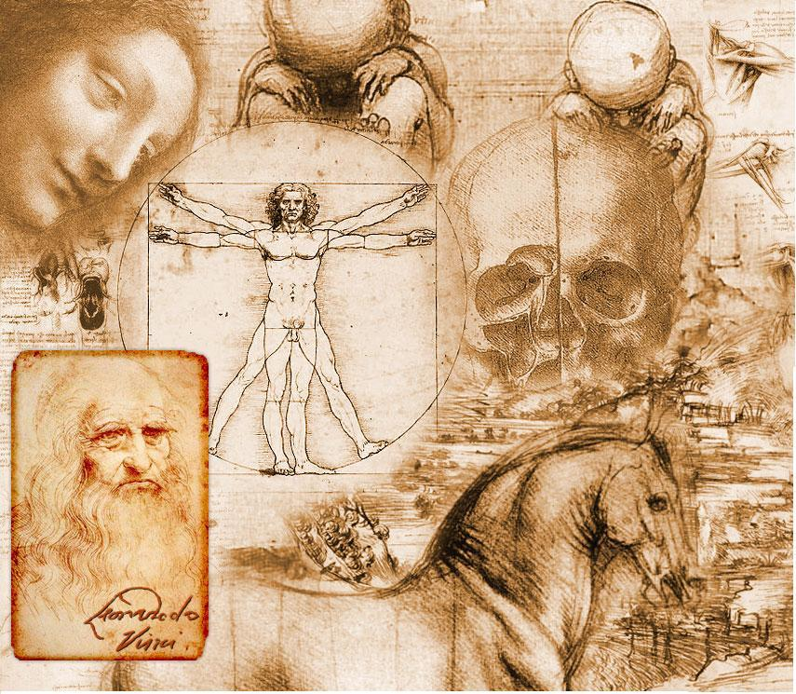
The Renaissance Period of Art and Science

Slide 2
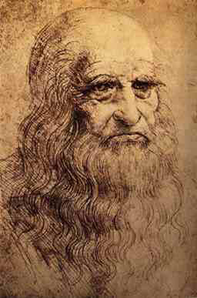
Leonardo dA Vinci

Slide 3
Birth name: Leonardo di ser Piero da Vinci
Date of Birth: 15th of April, 1452 at Vinci, Italy Demise: 2nd of May, 1519 at Amboise, France Nationality: Italian Parents: Since Leonardo was born to parents who were not legally married, he did not have a surname. His name 'Leonardo da Vinci', literally translates as 'Leonardo of Vinci' (Vinci was his birthplace in Italy). ✫ Leonardo never really attended school. However, he was informally taught to read and write at his father's house. Here, he was also given elementary training in languages, geometry, and arithmetic. ✫ Leonardo da Vinci was a vegetarian, and did not even drink milk in his life. ✫ He was left-handed and always wrote in mirror handwriting, perhaps to guard his ideas from intellectual thieves. ✫ He was famous for his love for animals. Sources tell us that many times, he used to purchase caged animals and birds, in order to set them free. ✫ Da Vinci is said to have left many of his paintings incomplete. Reportedly, he also destroyed a number of his own works. ✫ Leonardo did not make a self-portrait until almost 1515.

Slide 4
More on DaVinci
Leonardo da Vinci was a man of "both" worlds. He was a master of both of art and science. Leonardo was a painter, sculptor, architect, musician, engineer,inventor, and scientist. He lived in what is called the Renaissance period.
Leonardo Da Vinci's sketches helped our world in many ways. One, his scientific studies were recorded in his sketchbook, and provided much information on flight, as well as other scientific areas. Second, Da Vinci created excellent in-depth drawings of the human body, which helped doctor's and surgeons perform better during surgery. Finally, Da Vinci's study on building shapes and designs showed ideas on how to build for maximum space with limited supplies.

Slide 5
Da Vinci, during the 1400's made incredible strides in the area of science and invention. Still, at this time he was appreciated by no-one for his marvelous efforts. Today, it's hard to imagine what type of modern life we would have if it wasn't for Da Vinci's initial sketches and incredible brainstorms. One major area that was affected greatly by Da Vinci is warfare. Da Vinci created many models for unheralded weaponry. Also, he created strategic layouts and battle plans that would be marveled by military leaders for years to come. Overall, Da Vinci was definitely a man before his time.

Slide 6
Mona Lisa

Slide 7
The Last Supper

Slide 8
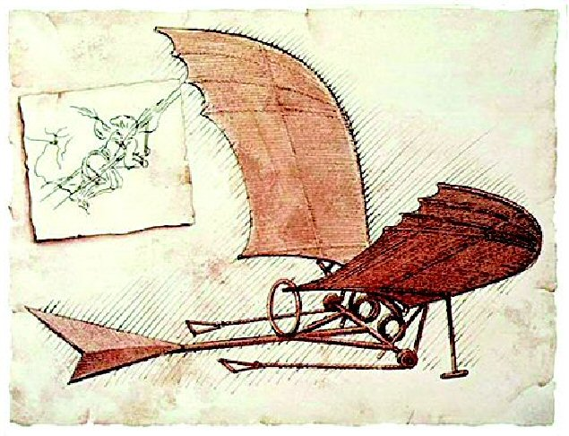
The Inventor

Slide 9
✫ Leonardo conceptualized and sketched the first flying machines, which included the working sketches of a parachute, a helicopter, a hang glider, and an airplane. ✫ Da Vinci conceptualized a 33-barrelled organ, a sort of a gun that could fire multiple bullets in quick succession. It surely seems like a prototype of a modern machine gun. Sketch of an Armored Tank ✫ He made, for the first time ever, a design of an armored tank, and considered it to be the ultimate war machine. ✫ He also devised a motor car for the first time ever in the history of mankind. It could function on its own without any human intervention, and so can be considered to be world's first robotic vehicle. ✫ The first ever humanoid robot was constructed in the 15th century by Leonardo da Vinci. This, he had actually built, and was used to entertain people. His notes have been used by NASA to design the planetary exploration robots.

Slide 10
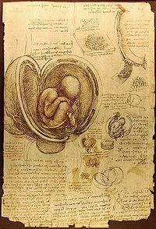
The Scientist

Slide 11
Springing from the “true to nature” ethos of his paintings, Leonardo’s fascination with the human body took him to the morgues and hospitals of Florence, where he performed dissections of corpses, often of executed criminals. His greatest feat was understanding the workings of the heart. http://www.brainpickings.org/index.php/2012/07/17/leonardo-da-vinci-anatomist/

Slide 12
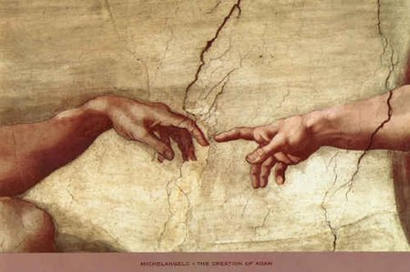

Slide 13
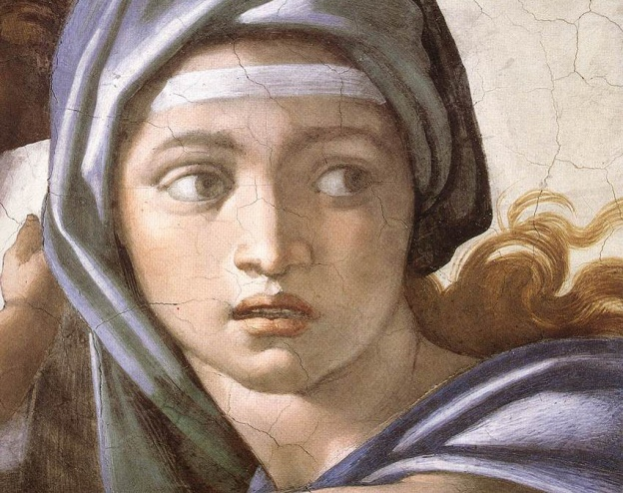
Humanism to the Renaissance
Renaissance Humanism is the spirit of learning that developed at the end of the middle ages with the revival of classical letters and a renewed confidence in the ability of human beings to determine for themselves truth and falsehood.

Slide 14
Michelangelo di Lodovico Buonarroti Simoni.

Slide 15
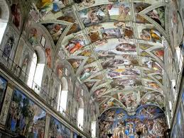
Sistine Chapel

Slide 16
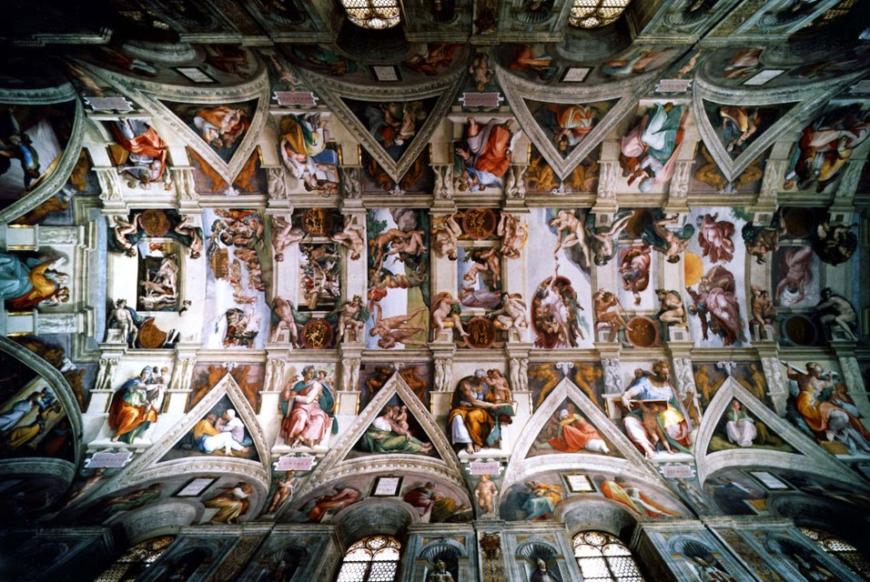

Slide 17
Michelangelo is one of the greatest artists of all time, a man whose name has become synonymous with the word "masterpiece": Michelangelo Buonarroti.
Michelangelo was caught between the conflicting powers and whims of the Medici family in Florence, and the Papacy in Rome.
He was an anatomist also.

Slide 18
Michelangelo di Lodovico Buonarroti Simoni, called Michelangelo, was an artist during the Renaissance. He was born in Italy in 1475. He was brilliant and talented in many ways; he could paint, sculpt, design buildings, and write poetry. He is best known for his sculptures and frescos (paintings on wet plaster). When Michelangelo was a child, his mother became ill and couldn’t care for him, so he was sent to live with a stonecutter and his wife. Michelangelo joked that this is where he learned to love cutting stone into sculpture. Michelangelo spent years studying the human body. He even looked at dead bodies so he could learn the way the muscles and bones were attached and how arms and legs moved. He drew sketches of people in various positions, concentrating on getting the muscles just right. Many of these sketches still exist so we can see how Michelangelo prepared to create his masterpieces.

Slide 19
Sistine Chapel
In 1505 Michelangelo returned to Rome. He was commissioned by the Pope in 1508 to paint the ceiling of the Sistine Chapel. Michelangelo considered himself to be a sculptor, but agreed to paint the Sistine Chapel for the Pope. He worked for four years, painting upside down on a scaffold in order to finish the painting. The painting was huge (141 feet long by 43 feet wide). It contained nine scenes from the Bible down its center and over 300 people.

Slide 20
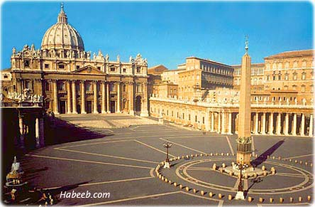
The Vatican

